Slide 1

Notes:
While you are waiting for the bus or in the queue or has some free time to spare, a fun and addictive game can seriously help with killing time.
So how about a game that improves your reflexes and test your multiplication skills?

Slide 2


Slide 3

Simple instructions
Improve reflexes
Family friendly
Notes:
What’s Up is a quick one-tap game with simple controls. It is easy to get started with, and even easier to get hooked on. It helps you to beat the boredom blues, while training your reflexes and reaction speed. It can also be played across all ages, ranging from primary school students to elderlies, bringing joy to everyone in the family!

Slide 4
What’s Up is a game that is easy to get started with and even easier to get hooked on
It beats the boredom blues and trains your reflexes
It can also be played across all ages, bringing joy to everyone in the family!
Notes:
What’s Up is a quick one-tap game with simple controls. It is easy to get started with, and even easier to get hooked on. It helps you to beat the boredom blues, while training your reflexes and reaction speed. It can also be played across all ages, ranging from primary school students to elderlies, bringing joy to everyone in the family!

Slide 5
Before the game starts, a number will be defined as UP.
When the game begins, you will search for the smallest tile in the grid and begin tapping them in ascending order.
New numbers will replace the tiles tapped.
When you encounter a tile that contains ,or is a multiple of the UP digit, you have to tap the UP button instead.
wild cards will also be generated and this creates uncertainties, making the game even more exciting.
Your score is calculated based on how many correct tiles you can tap within the time limit.
Within the time limit, tap as many tiles as possible and beat your own record!
Notes:
Introducting WhatsUp
[MVP]
Before the game starts, a number will be defined as UP. When the game begins, you will search for the smallest tile in the grid and begin tapping them in ascending order. When you encounter a tile that contains the UP digit or is a multiple of the UP digit, you need to avoid it by tapping the UP button instead. New random numbers will replace the tiles tapped. Your score is calculated based on how many correct tiles you can tap within the time limit.

Slide 6
wild cards will be generated and this creates uncertainties, making the game even more exciting.
Notes:
[] From time to time challenges like rotation of grid and wild card will introduce uncertainties and make the game even more exciting.

Slide 7
To up the challenge, play the game in multi-player mode! Challenge to see who has the fastest reflexes and let’s see who can make it till the end!

Slide 8
After an exciting round of game, share your scores on social media, and share the fun!
Notes:
[social integration]

Slide 9
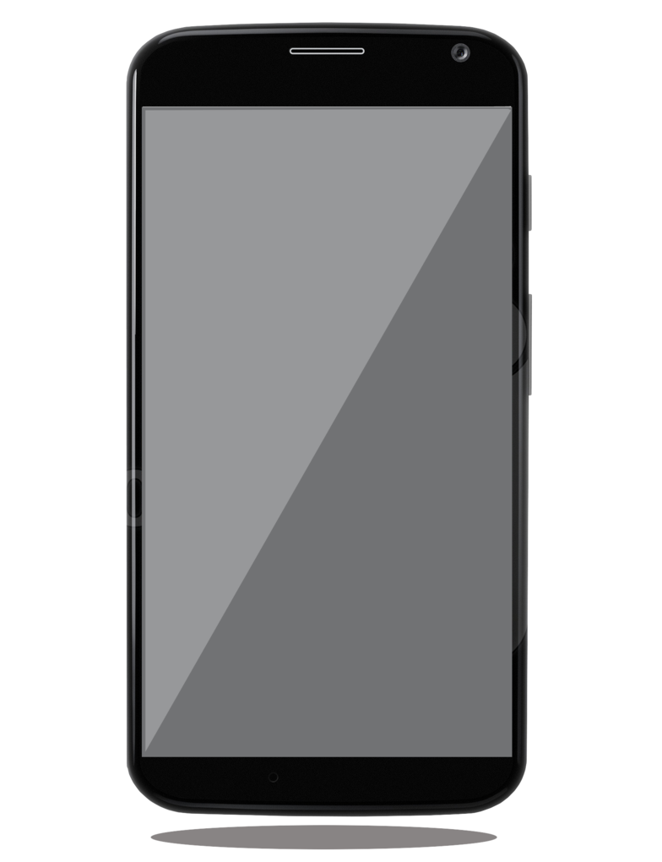
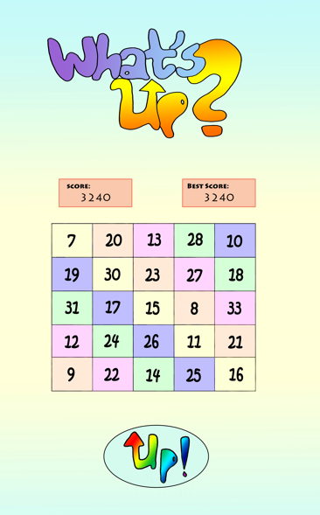
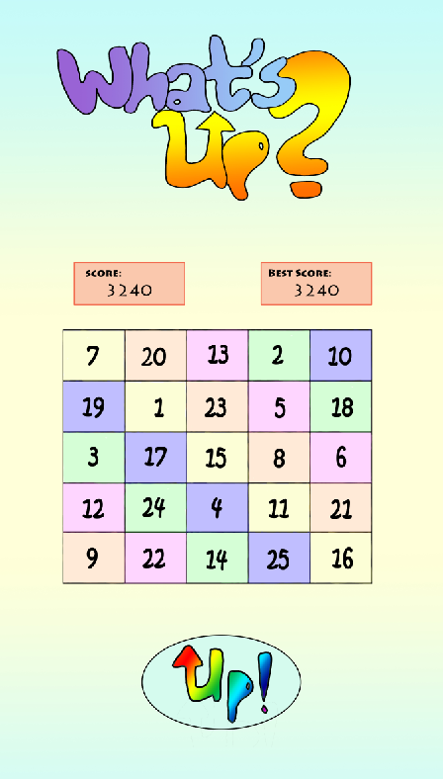
0

Slide 10
0

Slide 11
1

Slide 12
3

Slide 13
6

Slide 14
10

Slide 15
15

Slide 16
21

Slide 17
21

